Slide 1
Do You Even Multitask?
Team 1-up
Kelsey Merline
Irving De Jesus
Daniel Lawrence
Artist - Felicia Mccoy
Sound - Jesse Stevenson

Slide 2
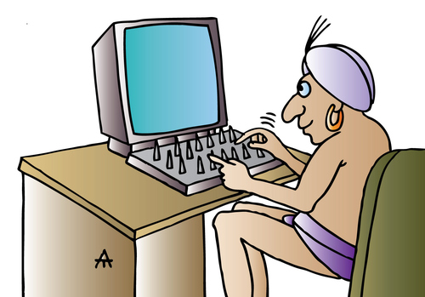
Genre & System Requirements
Genre
2D Arcade
System Requirements
OS: GNU + Linux
CPU: Intel Core i7-6800K 15M Broadwell-E 6-Core 3.4 GHz
GPU: 2 x Nvidia GTX 1080 8GB VRAM
RAM: 64GB 2300MHz
HDD: 80GB, 20GB for future DLC
Internet: 1GB/s required
Will run on PC but we do have plans to implement to handheld in the future

Slide 3
Game Mechanics
Gameplay
There will be two separate arcade games on the screen that the player must control simultaneously
Time
Player needs to try to survive in both games as long as possible
The further the player gets, the faster and more difficult the games start to play
Leaderboards
Top 5 player times will be available for competitive purposes
Lives
The player will also be given 3 universal lives and when all are lost, it is game over.

Slide 4

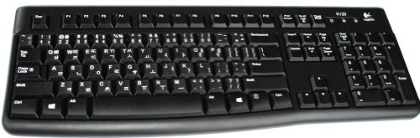
Hand Solo - Survival Space Run
Players will try to stay alive by dodging incoming tie fighters and rogue asteroids.
Taking a single hit from either enemies destroys your ship and your journey.

Slide 5

Save Alderaan - Missile Defense Game
The player takes control of defensive turrets on the ground that will defend the planet Alderaan
Missiles and bombs will fall from the sky
Missiles fall more frequently but are destroyed in one shot
Bombs fall slower less frequently and take two hits to destroy
When one explosive hits the ground the game ends

Slide 6
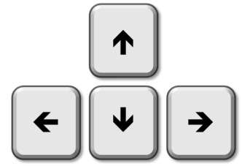
Game Controls & User Interface
User interface: The UI will be a simple screen split in half that will have both games running along with a timer. There will be three universal lives that can be lost in both games.
Controls:
Hand Solo:
The words require one hand to type and will be based on a QWERTY keyboard setup
Save Alderaan:
Aim and shoot with a mouse.

